Slide 1

Benni De Jagere
No coffee? No Insights!
Troubleshooting Power BI Report Performance
So you've built a Power BI report with all the shinies? Good!
After some usage, users have reacted that it's a bit sluggish in usage, and they're not keen on using it anymore.
Starting off with the new Performance Analyzer Pane, we'll demonstrate how you can pinpoint bottlenecks in your report, and take actions on these insights.
With the myriad of root causes that are out there, an elimination approach might suit us very well.
Some of the main causes will be explained, and we'll get you going on how you can fix it for yourselves.
This talk will place emphasis on leveraging external free community tools to assess the state of the data model, and go further on fixing the groundworks of your solution.
Attendees should note that is not a DAX Deep Dive class, before wandering in :-)

Slide 2
Troubleshooting Power BI Report Performance
Benni De Jagere
Senior Data Insights Consultant

Slide 3





Benni De Jagere?
Senior Data Insights Consultant
Realdolmen, a Gfi company
.be
@BenniDeJagere
/bennidejagere
#SayNoToPieCharts

Slide 4
Session Objectives
Leverage (external) options to pinpoint common causes
Techniques to avoid, or solve
Usable set of best practices
Not! a DAX or PowerQuery Performance Deep Dive

Slide 5
Why Troubleshoot Report Performance?
No one likes to wait

Slide 6
But also ..
“Works on my machine” is not a valid reply
Context and Baseline are Key
Aim for quick wins on heavily used reports
Avoid long investigations on barely used reports (unless it’s the CFO)
40% Science, 40% Art, 20% Luck
It depends!

Slide 7
Hold on ..
01

Slide 8

PowerBI.com
http://www.51mon.co.uk/photo/MrNoisyNeighboursMCFC.jpg

Slide 9
PowerBI.com
Shared Resources, blessing and curse
Premium Capacity does not automagically solve performance issues
Beware of Cache mechanisms

Slide 10
The Report Case
02

Slide 11

Use Case
https://elidesc.com/wp-content/uploads/2012/07/Velo_Antwerpen.jpg

Slide 12

New York Citibikes
www.citibikenyc.com/system-data
Public Open Data
Starts June 2013
Information about every trip
Longer than 60 seconds
Starts at public station
Masterdata
https://i0.wp.com/thenypost.files.wordpress.com/2013/12/citibike1.jpg?quality=90&strip=all&ssl=1

Slide 13
The Report(s)
03

Slide 14
Inside Power BI Desktop
04

Slide 15
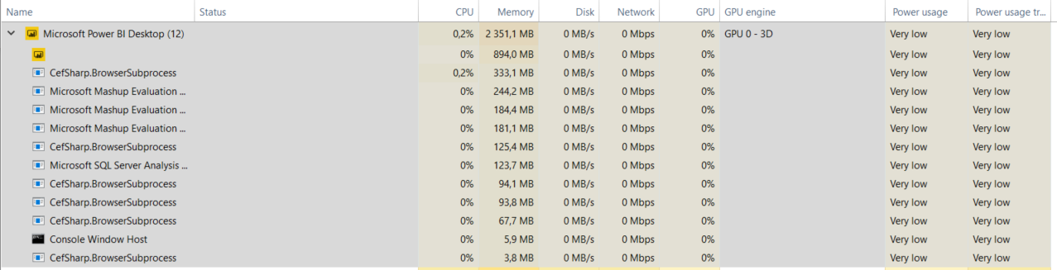
Inside Power BI Desktop

Slide 16
Tools for the Trade
05

Slide 17
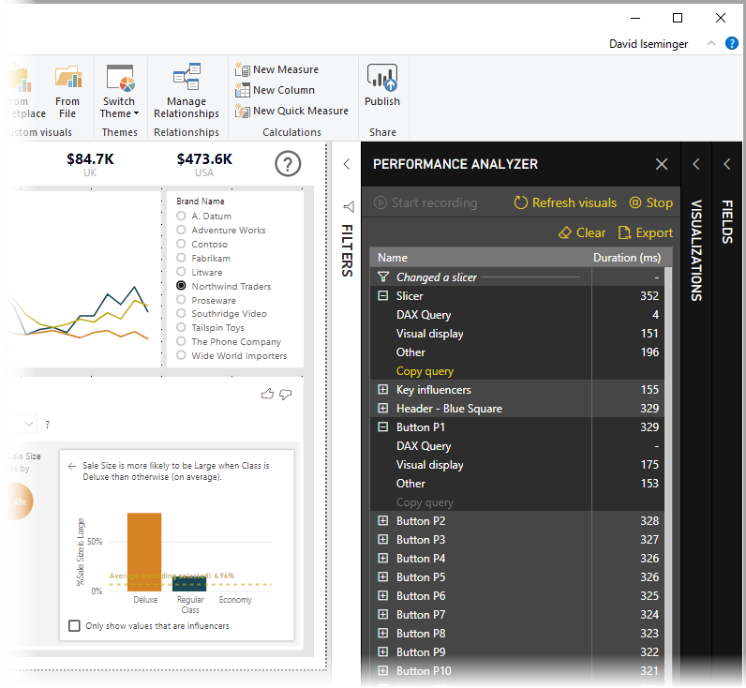
Performance Analyzer Pane
Public Release in May 2019
Flight Recorder for all operations
Breaks down execution times
Export results with ease
https://docs.microsoft.com/en-us/power-bi/media/desktop-performance-analyzer/performance-analyzer-01.png

Slide 18
Tools for the Trade
Performance Analyzer Pane
DAX Studio (SQLBI.com)
VertiPaq Analyzer (SQLBI.com)
Tabular Editor
Power BI Helper
Power BI Field Finder
Power BI Sentinel (€)
And more ..

Slide 19
The Tips & Best Practices
06

Slide 20
The Golden Rule(s)
Transform early
Transform once
Transform smart

Slide 21
Data Types

Slide 22
Auto Date/Time

Slide 23
Column/Row Usage

Slide 24
Modelling

Slide 25

Modelling Tips
Thanks, @KoVer ☺

Slide 26
Modelling Tips
Star Schema (all the things!)
Use persisted surrogate keys for relationships
Avoid Bi-Directional filtering (rather DAX Crossfilter)
Disable auto date/time, rather ‘Mark as Date Table’
Debate Role-playing dimensions
Optimize Data Types

Slide 27
Modelling Tips (continued)
Avoid wide tables
Remove unused columns and rows
Only load queries that are used
Reduce inappropriate summarization
Think about your data granularity
Hide (or remove) Key fields from the model view
Consider your source and refresh schedule

Slide 28
Power Query

Slide 29
PowerQuery Tips
Query Folding, when possible
Don’t repeat tables & fields
Only load tables that are used in the model
Specify correct Data Types
Parameterize ‘fact’ queries (Date or Entity)

Slide 30
DAX

Slide 31
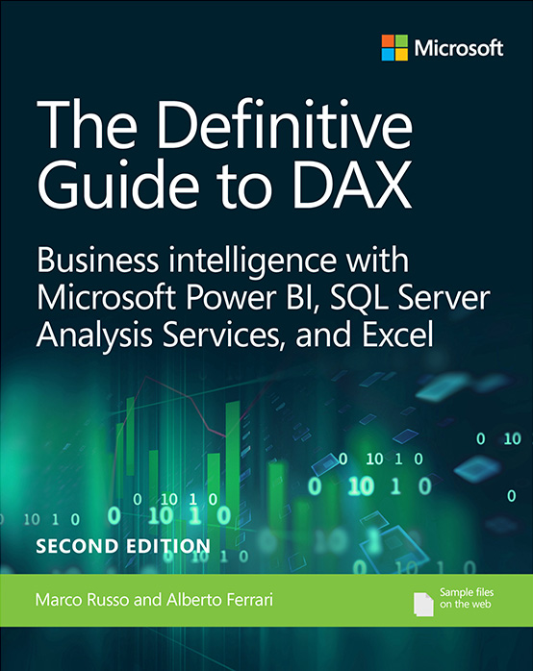
DAX Tips
Avoid ‘repeater’ functions (SumX, AverageX, ..)
Avoid calculated columns
Keep measures simple initially, and add complexity incrementally.
Use variables
Solve the model, then solve DAX
Use Data Categories
Read the Bible ☺

Slide 32
DAX Formula Engine & Storage Engine
Category | Formula Engine | Storage Engine
Query received | Interpret DAX/MDX formula | Can handle single logic (xmSQL) from formula Engine
Target Data | Iterate over datacaches produced by storage engine (datacaches are in-memory tables) | Iterate over compressed data in vertipaq column stores
Result | Produce result set and send back to requestor | Produce Datacaches send back to formula Engine
Thread | Single – Threaded | Multi – Threaded
Cache utilization | No | Yes
Area of focus for Performance Tuning | Check physical plan for bottleneck | Check xmSQL query for bottleneck

Slide 33
Reports

Slide 34
Report Page Tips
Limit visuals on a single pane
Filtering and slicing before rendering is a valid option (ie. Landing page, Report Filters, ..)
Avoid having 5+ report tabs on a single report
Avoid interaction between visuals when they’re not needed
Avoid overly detailed visuals
Be aware of render intensive visuals (ie. Maps, Custom visuals, ..)

Slide 35
Bonus Round

Slide 36
Composite Models & Aggregations
Composite models (and DirectQuery) require proper usage of DAX
Use these wisely
Aggregations cost memory, data refresh time
Solve specific performance issues

Slide 37
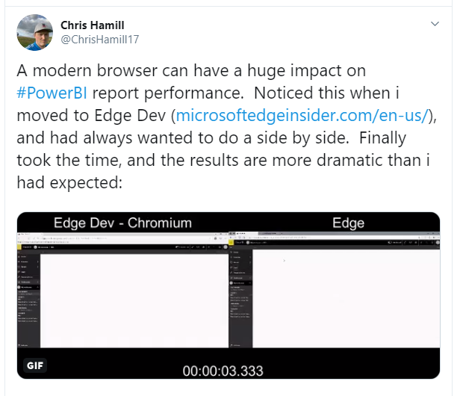
Battle of the Browsers
https://twitter.com/ChrisHamill17/status/1160242636369694720

Slide 38
Takeaways
Report performance should be thought of at design time
Think about your transforms
Modelling is key
Choice of browser and hardware matters
Create a personal set of best practices for Tabular Editor
Read public (online) resources

Slide 39
Resources
https://docs.microsoft.com/en-us/power-bi/power-bi-reports-performance
https://docs.microsoft.com/en-us/power-bi/guidance/import-modeling-data-reduction
https://docs.microsoft.com/en-us/power-bi/guidance/star-schema
https://sqlserverbi.blog/2019/08/24/power-bi-project-good-and-best-practices/
https://docs.microsoft.com/en-us/power-bi/desktop-performance-analyzer
https://docs.microsoft.com/en-us/power-bi/visuals/power-bi-visualization-best-practices
https://www.sqlbi.com/books/the-definitive-guide-to-dax-2nd-edition/

Slide 40
Resources
https://www.sqlbi.com/tools/
https://github.com/otykier/TabularEditor
https://powerbi.tips/2020/04/tabular-editor-rocks/
https://www.youtube.com/playlist?list=PLn1m_aBmgsbGDZb7ydd8_LS1AfosdRndQ
https://powerbihelper.org/
https://github.com/stephbruno/Power-BI-Field-Finder
https://www.sqlbi.com/articles/comparing-dax-calculated-columns-with-power-query-computed-columns/
https://www.sqlbi.com/tv/my-power-bi-report-is-slow-what-should-i-do-2/
https://www.biinsight.com/four-different-ways-to-find-your-power-bi-desktop-local-port-number/
https://blog.crossjoin.co.uk/2019/12/02/testing-performance-of-power-bi-reports-in-the-browser-part-1/

Slide 41
Benni De Jagere?
Senior Data Insights Consultant
Realdolmen, a Gfi company
.be
@BenniDeJagere
/bennidejagere
#SayNoToPieCharts

